Slide 1
Yandex Lyceum: MP3 Player
By Saparov Almas

Slide 2
About project
In this project I created mp3 player. Features of mp3 player include:
Playing mp3 music
Playing audio from YouTube by title or link of video
Working with playlists

Slide 3
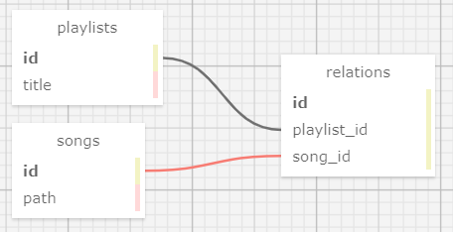
Database
This application uses database as a place where to save information about playlists. The database itself consists of three tables: playlists, relations, songs. The first table represents a list of the names of playlists, the third for storing paths for songs, and the second represents the relationship between them. For comfortable interaction with database in application, I created two classes: db_playlist, db_song

Slide 4
Downloading audio from YouTube
For downloading Youtube audio I used youtube dl library. For inspecting title of video I used bs4 library. To get link by it title I used urllib library
def searh_by_name(music_name): query_string = urllib.parse.urlencode({"search_query": music_name}) formatUrl = urllib.request.urlopen("https://www.youtube.com/results?" + query_string) search_results = re.findall(r"watch\?v=(\S{11})", formatUrl.read().decode()) link = "https://www.youtube.com/watch?v=" + "{}".format(search_results[0]) return link

Slide 5
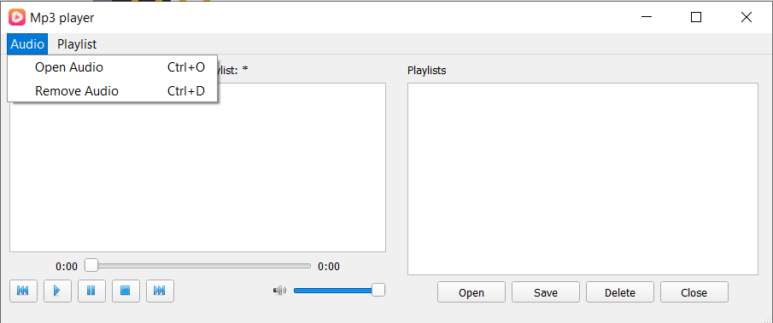
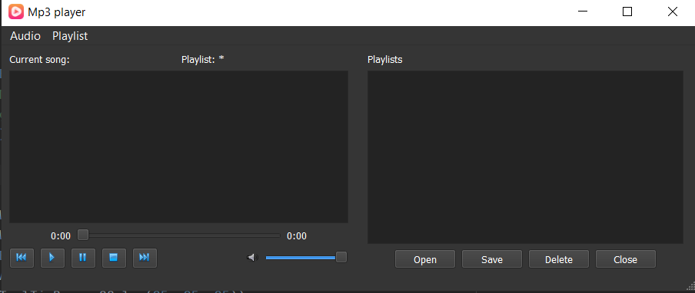

Screenshots

Slide 6
Demonstration
MP3 Player

Slide 7

Thanks!
Any questions?

